Slide 1
CSE 12 – Basic Data Structures and Object-Oriented Design Lecture 3
Greg Miranda, Spring 2021
This lecture is being recorded

Slide 2
Announcements
Quiz 3 due Monday @ 12pm
Survey 1 due tonight @ 11:59pm
Discussion starts today @ 1pm

Slide 3
Topics
Questions on Lecture 3?
Interfaces

Slide 4
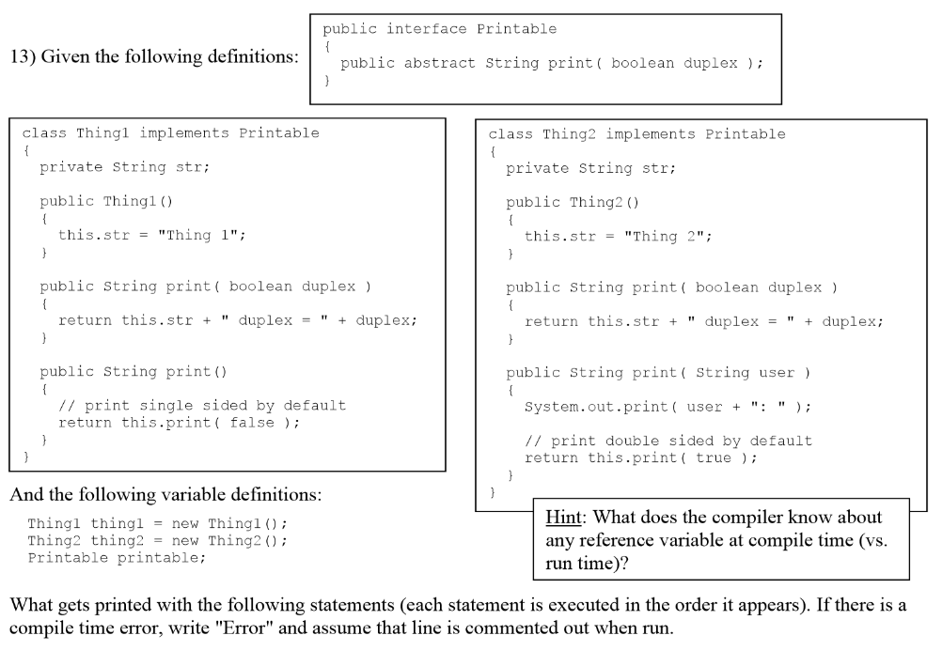
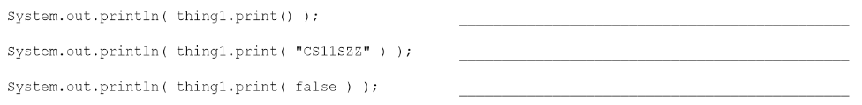



Slide 5
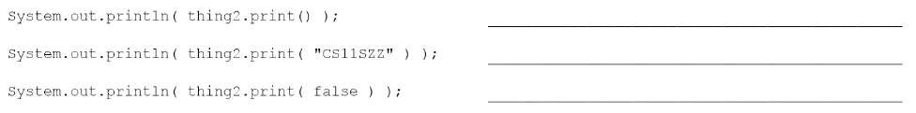

Slide 6
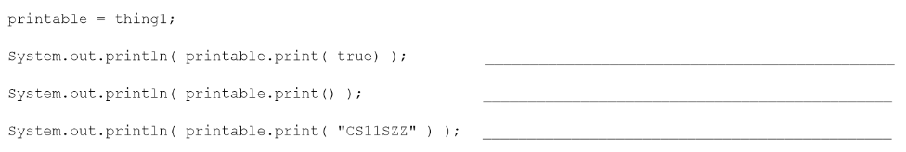




Slide 7
